Slide 1
Predicting Ticket Prices for Big Mountain Resort
Jimmy Blackburn
Alesha Eisen
Sathwik Kesappragada

Slide 2
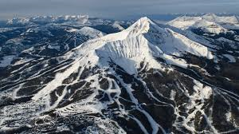
Context
Big Mountain Resort, one of 12 summits in Montana, is struggling to make gains off of its current state
Located near extremely popular tourist attractions: Glacier National Forest and Flathead National Forest
Every year on average 350,000 visitors come to ride and explore the mountain
105 runs
14 total chairs
3000 acres of skiable terrain
600 acres of night skiing
Current Ticket price for Adult Weekday and Adult Weekend: $81
Most Expensive Resort in Montana

Slide 3
Problem Statement
Develop a new strategy for determining a fair ticket price and/or cut costs to ensure BMR has a net profit
Compare BMR with its competitors
Identify any key features that help boost the ticket price and summit revenue
If established, quantify how much needs to be changed

Slide 4
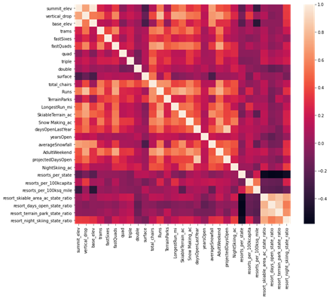
Data
330 resorts across America with 27 features
number of runs
size of snowmaking terrain
number of fast quads
area for night skiing
Compare BMR with other summits
Look for correlation between key aspects and ticket price
70% for training set, 30% test set

Slide 5
Models
 | Linear Regression | Random Forest
Mean Absolute Error | 11.793465668669327 | 9.537730050637332
Mean, Standard Deviation | (10.49903233801529, 1.6220608976799664) | (9.644639167595688, 1.3528565172191818)
Ran a simple linear regression model
80% of the variance was covered for the training set
70% of the variance was covered for the test set
Ran a Random Forest model
Better CV results
More options to tune
Number of fast quads, number of runs, snow making area, and vertical drop

Slide 6
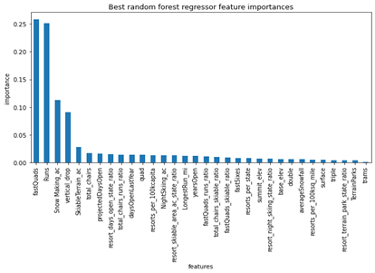
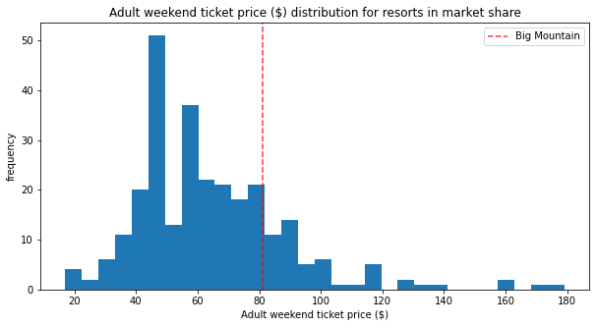
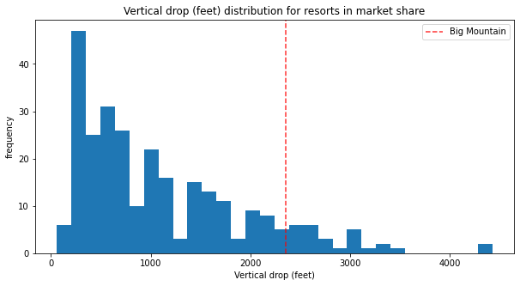
Charts
These visualizations display where BMR is situated amongst its opposition
Above average in most sectors

Slide 7
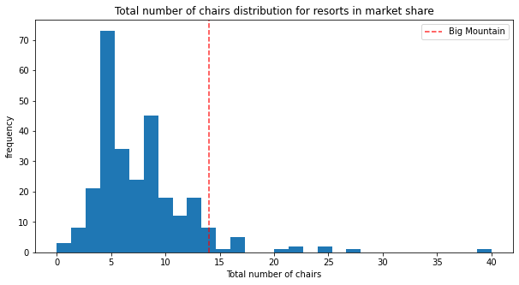
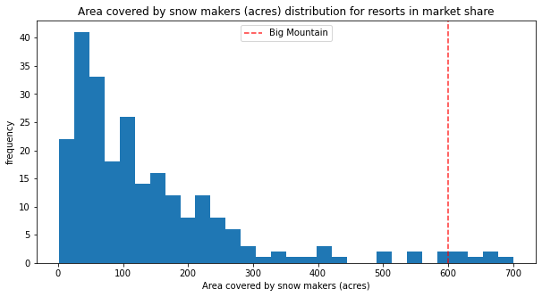
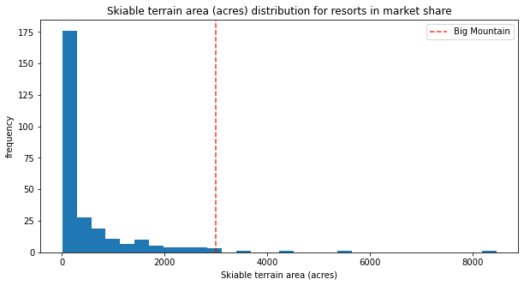
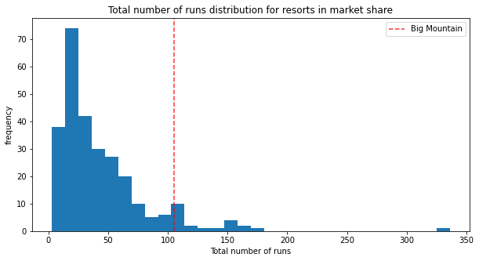
Charts (cont.)

Slide 8
Results & Suggestions
Refitted the model after removing Big Mountain Resort from the dataset
Closure of runs only yield to cheaper tickets and loss in revenue
In similar manner, by adding one more run, 150 more feet to the vertical drop, and one more chair can make up for a $1.99 increase in ticket price which in turn yields to $3,474,638 for the whole season
Tried adding a couple more features such as extending the longest run by 0.2 miles and snow making area by 4 acres
44% of revenue gains will be redirected towards operational costs
Modeled ticket price is much higher than actual price meaning BMR could be undercharging
Raising prices while expanding on a couple facilities generates net profit

Slide 9
Conclusion
After research, we found adding one more run, one more chair, and 150 feet to the vertical drop, BMR will gain $1,934,638 over the course of one season
BMR on average is above the mean in all aspects
Closure of Runs isn’t helpful
Random Forest Model gave better results with a lower MAE
Model is adjustable

